Slide 1
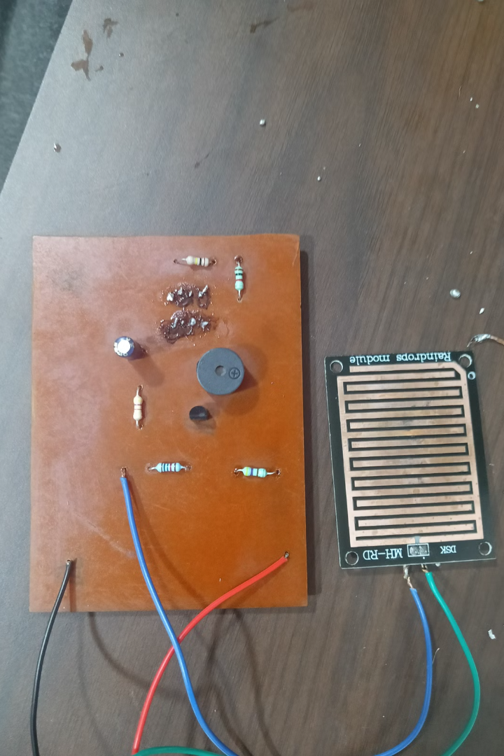

Rain Alarm using 555 Timer IC
This presentation explores the design and implementation of a cost-effective rain alarm system using a versatile 555 timer IC. The alarm system utilizes the timer IC to detect rainfall and trigger an audible alert, offering a practical solution for various applications.

Slide 2
Introduction
What is a Rain Alarm?
Why the 555 Timer?
A rain alarm is a device that detects rainfall and triggers an audible alert. It's used in situations where knowing about rainfall is crucial, such as agricultural applications, weather monitoring, or automated systems.
The 555 timer IC is a popular choice for designing electronic circuits. Its versatility, low cost, and ease of use make it suitable for building various types of timers, oscillators, and other applications like this rain alarm.

Slide 3
Components
555 Timer IC
Resistors
The heart of the rain alarm, responsible for generating the timing signal.
Used to control the current flow and time constants in the circuit.
Capacitors
Transistor
Store electrical energy and help filter out unwanted noise in the signal.
Acts as a switch to amplify the signal from the timer and drive the speaker.
Buzzer
Rain Sensor
Produces the audible alarm signal.
Detects rainfall and triggers the timer circuit.

Slide 4




Block Diagram
Rain Sensor
1
Detects rainfall.
555 Timer
2
Generates timing signal.
Transistor
3
Amplifies the signal.
Buzzer
4
Produces the alarm.

Slide 5
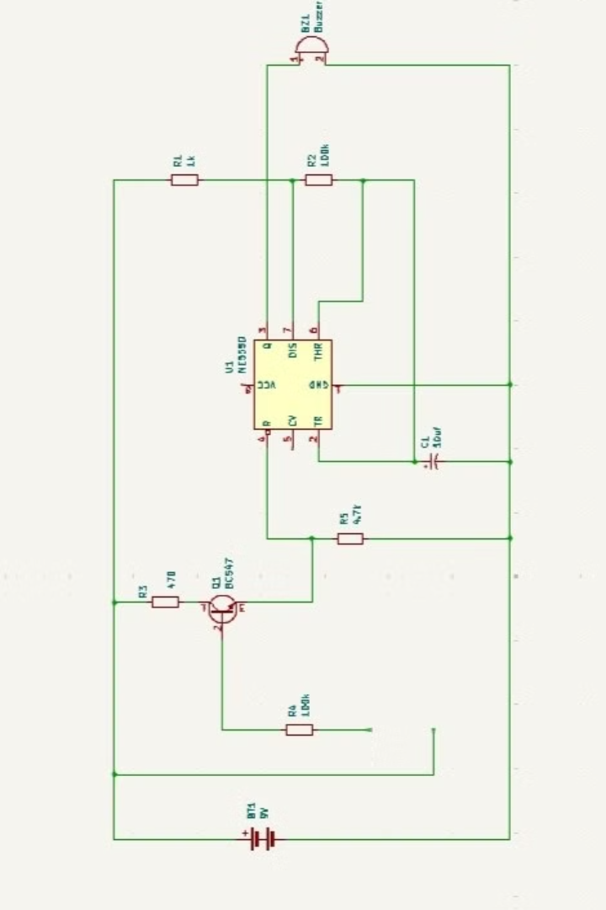




Circuit Diagram
Rain Sensor
When rainfall hits the sensor, it completes the circuit.
Timer IC
The timer generates a pulse when the circuit is completed.
Transistor
The transistor amplifies the pulse from the timer.
Buzzer
The amplified signal from the transistor drives the speaker.

Slide 6
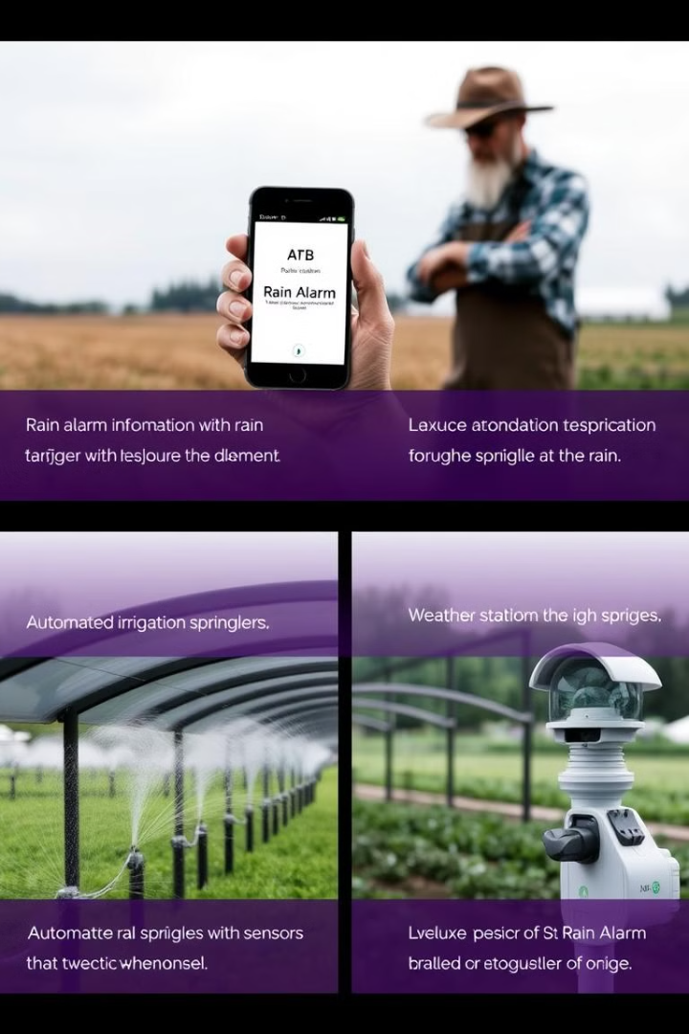




Uses and Applications
Agriculture
Vehicle Protection
Alerts farmers about rainfall for timely irrigation or harvesting.
Notifies car owners about rainfall to protect their vehicles.
Automated Irrigation
Weather Monitoring
Triggers automatic irrigation systems when rainfall occurs.
Part of a weather station for accurate rainfall data collection.

Slide 7
Simulation and Fabrication
Circuit Simulation
Fabrication
Simulating the circuit using software like Multisim or Proteus allows for testing and optimization before fabrication.
Once the circuit design is finalized, it can be fabricated by soldering the components onto a breadboard or a printed circuit board.

Slide 8

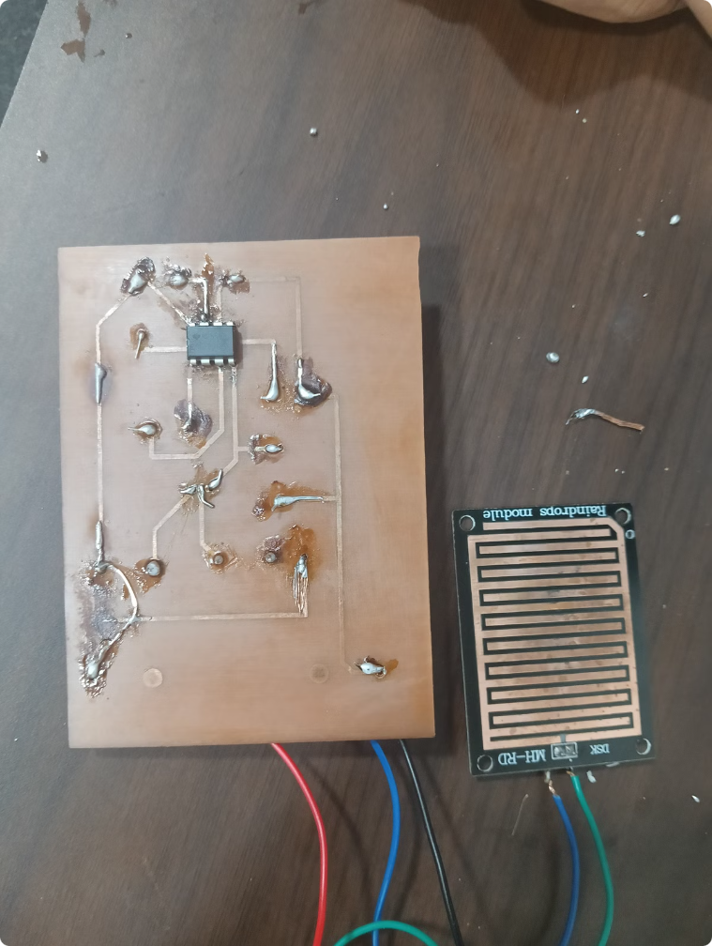

Output and Application
1
2
Audio Output
Working video link:
When rain hits the sensor, the speaker produces a distinct audible alarm.
3
Customization
The alarm system can be customized with different alarm tones and sensitivity levels.

Slide 9

Conclusion and Future Scope
The rain alarm system developed using the 555 timer IC is a cost-effective and reliable solution. Future improvements could include adding features like adjustable sensitivity, remote monitoring, and integration with other IoT devices. This opens up a wide range of possibilities for incorporating the rain alarm into various applications.

